Slide 1
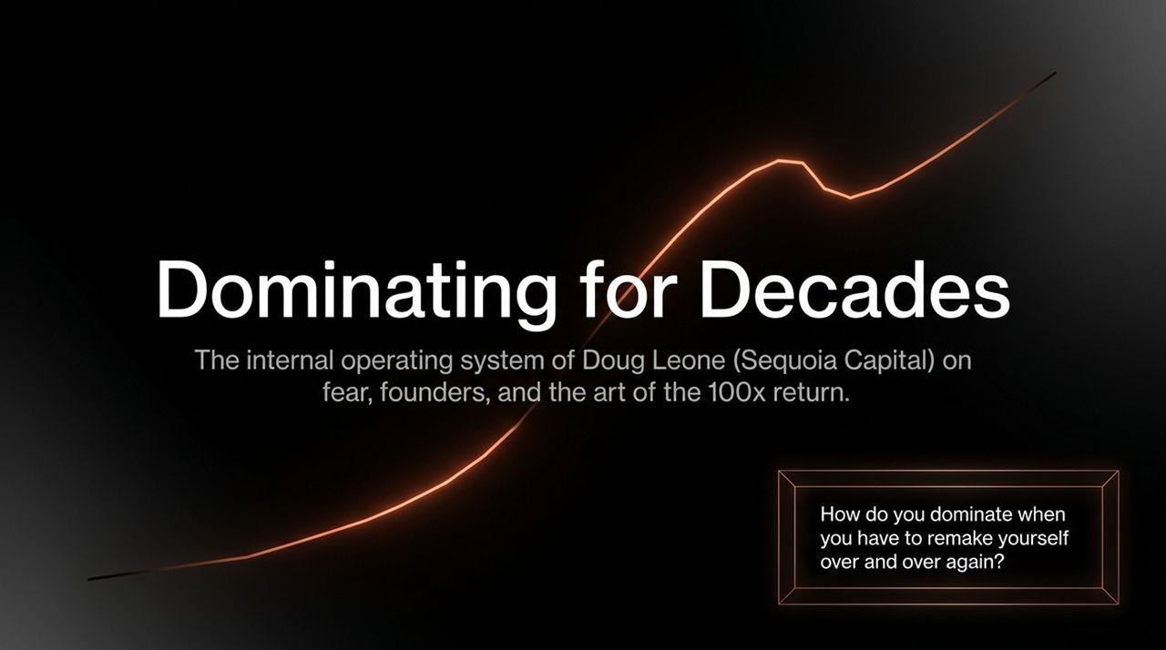
Notes:
Most business literature tells you to mitigate fear or view it as a barrier. Doug Leone turns fear on its head: he uses it as immediate propulsion. Whenever he feels fear—whether it's public speaking, heights, or market shifts—he treats it as an absolute challenge to confront head-on.
Consider "The Dentist Test": Early in his Sequoia career, Doug had to go directly from a root canal to a high-stakes board/partner meeting. He instructed his dentist to drill without Novocaine.
Why? He wanted to test if he was a "fake badass" on the outside or a real badass on the inside. To push through the severe pain, he used a mental frame: "This is just nerve endings going to my spine. Soldiers go to war and lose limbs—that's pain with consequences. Mine is severe pain with zero long-term consequence.

Slide 2
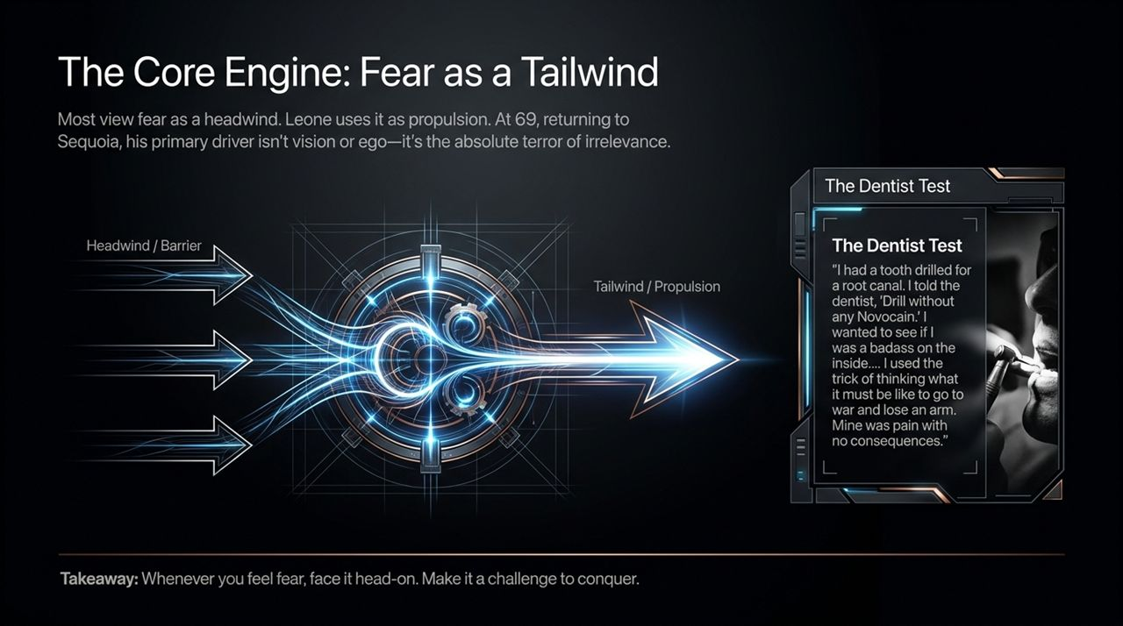
Notes:
Most people view fear as a stop sign or a headwind. Doug Leone treats fear as rocket fuel. At 69, returning to active duty at Sequoia, his driver isn't vision or legacy—it’s the genuine terror of becoming out-of-date and irrelevant. When you feel fear, the directive is immediate: don't hesitate, step directly into it.

Slide 3
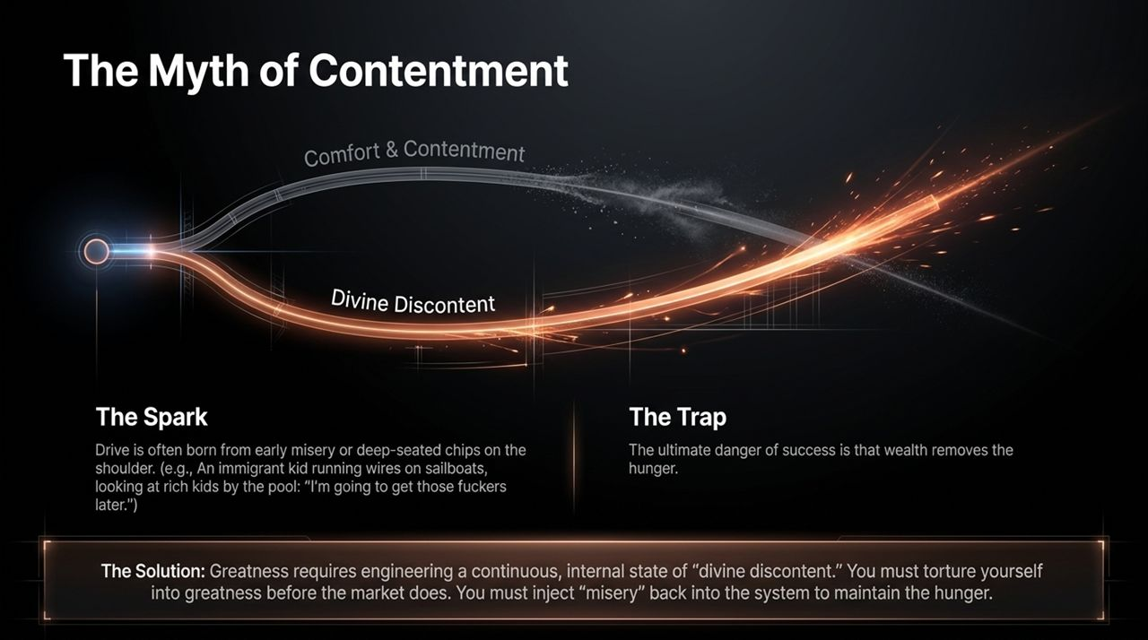
Notes:
Where does true drive come from? Doug argues it is almost always born from early hardship, chips on shoulders, or feeling like an outsider.
As an immigrant kid from Italy who was mocked for not speaking English, Doug worked summer jobs crawling through sailboats, running electrical wiring in the sweltering heat. Across the water at the country club, wealthy kids were lounging by the pool. Doug looked over and thought: "I’m going to get those fuckers later."
The Trap: Success, wealth, and comfort naturally strip away that raw hunger.
The Solution: To achieve longevity, you must reject comfort and embrace David Ogilvy’s concept of "Divine Discontent". You must artificially inject "misery" or extreme challenges back into your life/system to keep the hunger alive before the market forces it upon you

Slide 4
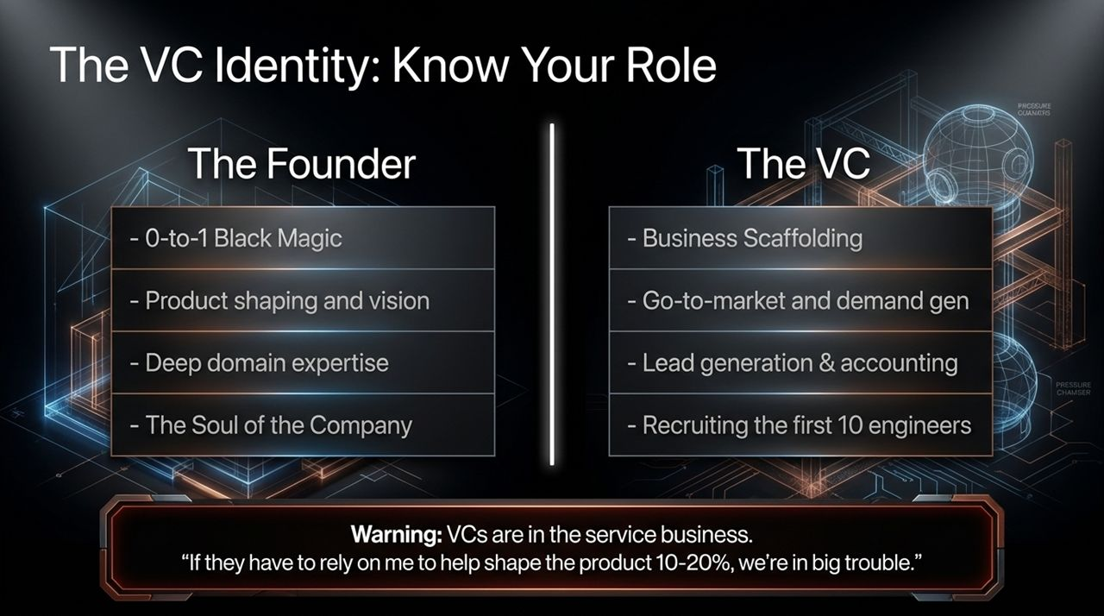
Notes:
Venture capital requires radical humility regarding your actual role. VCs are strictly in the service business.
The founder holds the "0-to-1 Black Magic"—the product vision, domain magic, and the core soul of the company.
Doug is explicit: "If a founder relies on me to shape 10% to 20% of their product, we are in deep fucking trouble."
A great VC provides Business Scaffolding: how to sell shares instead of just products, demand generation, GTM scaling, accounting, and helping recruit the first 10 mission-critical engineers.
Learn your lane: preserve the founder as the soul of the business, while you build the surrounding organizational muscle.

Slide 5
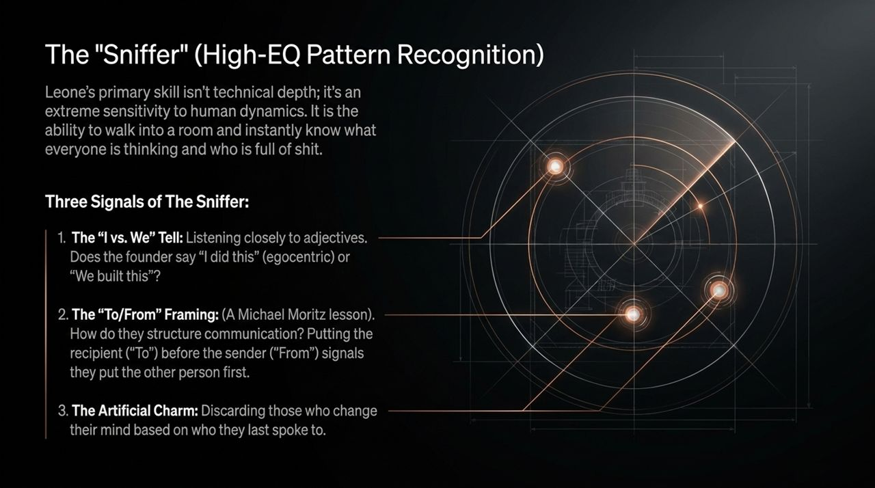
Notes:
Doug spent decades sitting on cybersecurity and fintech boards despite having zero technical background in those fields. His unfair advantage is what he calls "The Sniffer"—a hyper-attuned emotional intelligence (EQ) for human dynamics.
Three Key Signals of The Sniffer:
"I vs. We" Adjectives: Listening closely to language. Does the founder say "I built this, I sold this" (egocentric) or "We achieved this"?
"To/From" Framing: A lesson learned from Michael Moritz. Memos written as To / From rather than From / To put the recipient first, signaling humility and customer/team focus.
Artificial Charm / Opportunism: Instantly filtering out "chameleons" who shift their opinions based on the last person they spoke to.

Slide 6
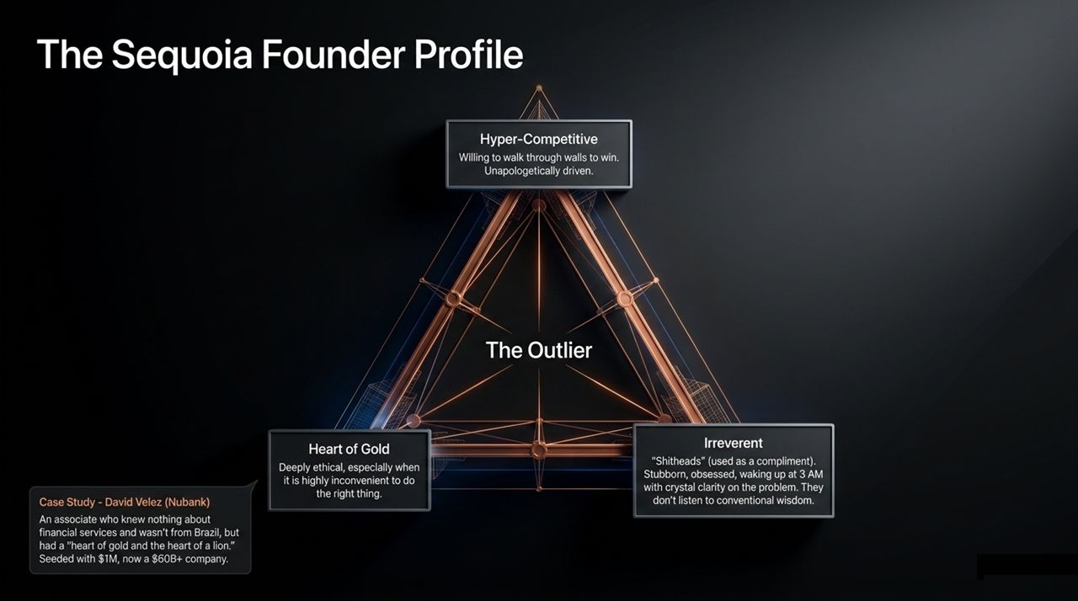
Notes:
What makes an outlier founder? Sequoia looks for traits that standard corporate environments view negatively: irreverent, stubborn, obsessed "shitheads" who wake up at 3 AM with crystal clarity on a problem.
The Profile Triangle:
Hyper-Competitive: Willing to walk through walls to win.
Irreverent Outlier: Ignores conventional wisdom and refuses to bend to consensus.
Heart of Gold & Heart of Lion: Deeply ethical—especially when doing the right thing is highly inconvenient—combined with ruthless determination.
Case Study (David Vélez - Nubank): David was a young Sequoia associate with zero financial services experience and not native to Brazil. Yet he had the heart of a lion and gold. Sequoia seeded him with $1M; Nubank grew into a $60B+ public powerhouse.

Slide 7
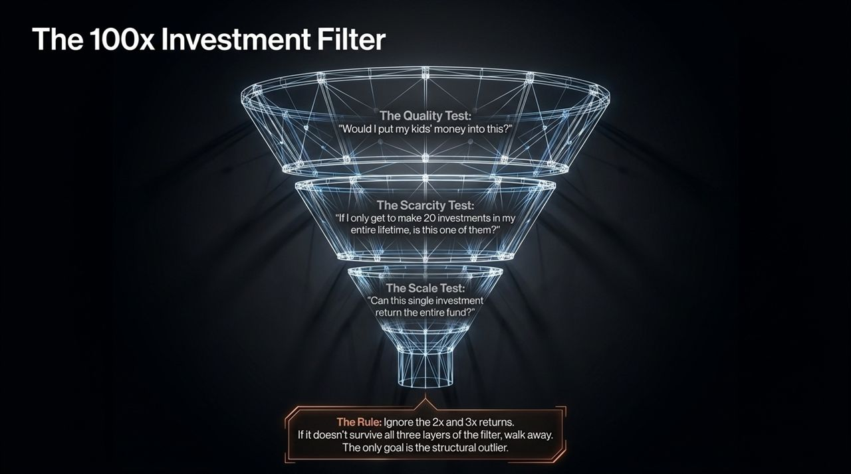
Notes:
Early in venture, you evaluate hundreds of decent businesses that can return 2x or 3x. Doug filters those out entirely. The goal of top-tier VC is solely finding 100x structural outliers.
The 3-Step Heuristic Filter:
The Quality Test: "Would I put my own kids' money into this?" (Evaluates core business quality/integrity).
The Scarcity Test: "If I only get to make 20 investments in my entire lifetime, is this one of them?" (Raises the bar of selectivity).
The Scale Test: "Can this single investment return the entire fund?"
If an opportunity fails any single layer, walk away.

Slide 8
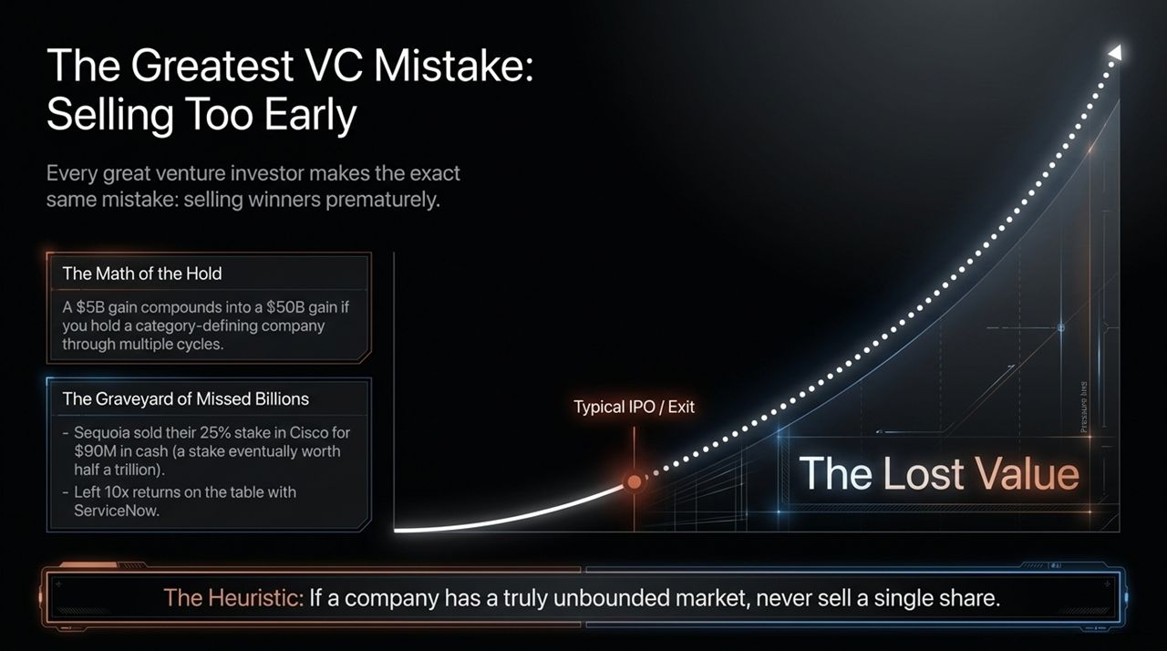
Notes:
Doug admits that virtually every elite venture capitalist makes the exact same catastrophic mistake: selling winners prematurely.
The Math of the Hold: Category-defining companies compound exponentially post-IPO. A $5B gain allowed to compound across 15–20 years turns into $50B+.
The Graveyard of Missed Billions: Sequoia sold its 25% stake in Cisco Systems for $90M cash—a stake later worth $100B+. They distributed ServiceNow early, leaving 10x upside on the table.
The Core Rule: If a company possesses a truly unbounded market and a refounding mindset, never sell a single share.

Slide 9
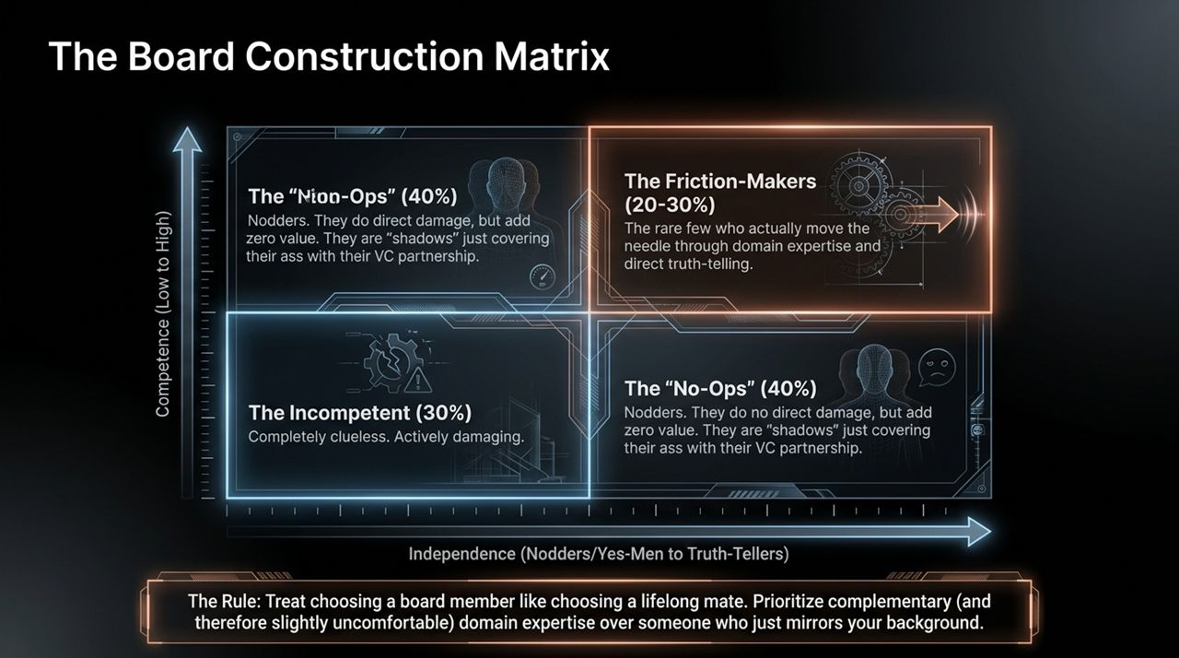
Notes:
Board construction is often treated casually, yet a board is like a lifelong marriage.
Doug breaks down the venture board ecosystem across two axes: Competence and Independence:
30% Incompetent: Completely clueless operators who do direct, active damage.
40% "No-Ops" / Nodders: They do no immediate damage, but add zero value. They sit on the board as "shadows" just trying to cover their ass with their VC firm partnership.
20–30% Friction-Makers / Value-Add: The rare operators with deep domain expertise who move the needle through direct, uncomfortable truth-telling.
Rule of Thumb: Prioritize complementary, slightly uncomfortable domain expertise over yes-men who just echo your background.

Slide 10
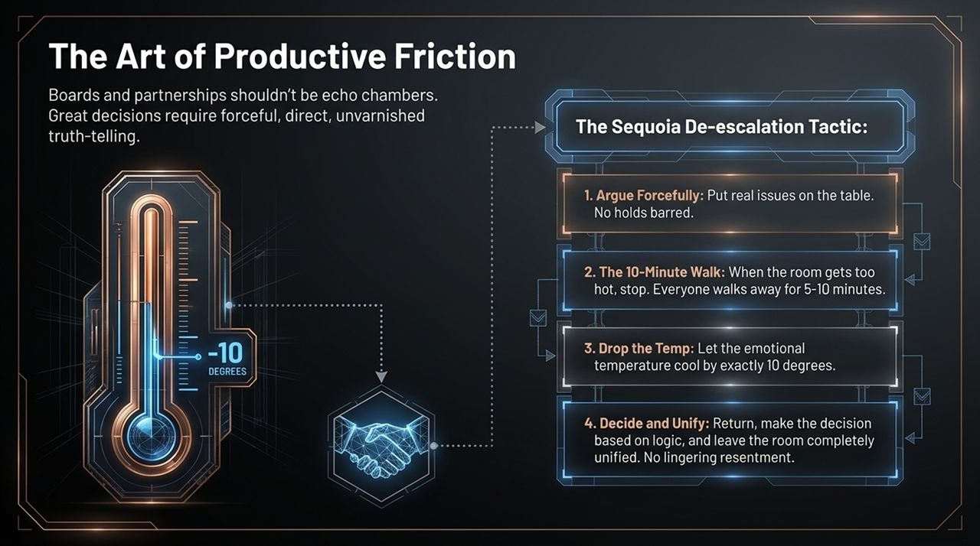
Notes:
Great partnerships and boardrooms are not echo chambers. High performance demands forceful, unvarnished truth.
The Sequoia De-escalation Protocol:
Argue Forcefully: Put real, uncomfortable issues on the table. No sugarcoating or corporate diplomacy.
The 10-Minute Walk: When arguments overheat, pause the room. Everyone steps outside for 5–10 minutes.
Cooling by 10 Degrees: Let emotional heat dissipate. Re-enter the room focused strictly on logic.
Decide & Unify: Make the firm call. Once you walk out that door, everyone is 100% unified with zero lingering resentment.

Slide 11
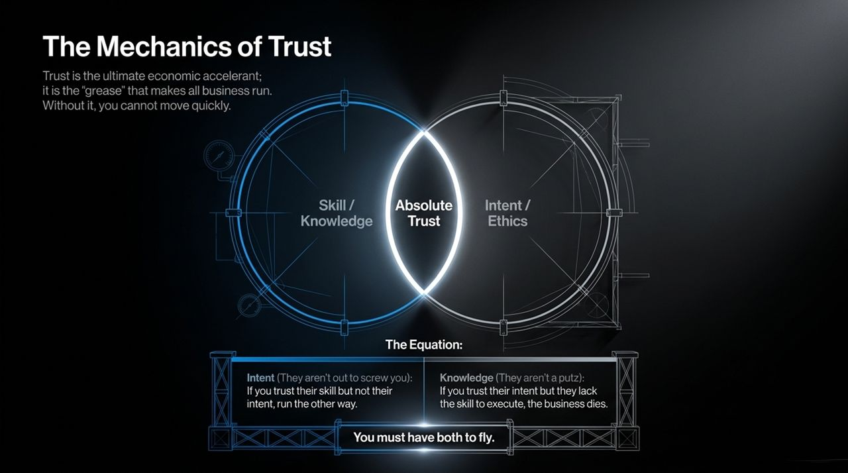
Notes:
When Doug wrote Sequoia’s institutional tenets, he put Performance as #1 and Teamwork as #2. He later realized he forgot the "Zeroth Tenet": TRUST.
Trust acts as the ultimate economic accelerant—it is the "grease" that allows organizations to make moves at lightspeed.
The Trust Equation: Trust requires both Intent/Ethics and Skill/Knowledge.
If you trust someone’s ethics but think they lack skill, you can’t trust their execution.
If you respect their skill but distrust their intent, you run away immediately.
Absolute trust enables seamless, hand-shake-level execution without bureaucracy.

Slide 12
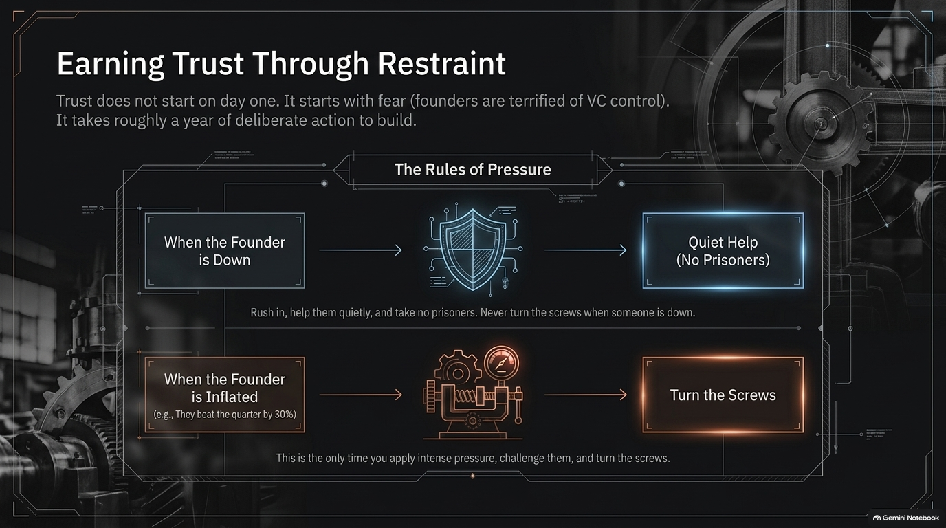
Notes:
For 26 years leading Sequoia, Doug flipped the traditional leadership model upside down. He repeatedly told his partners: "You don't work for me. I work for you."
The Stakeholder Hierarchy:
Founders First: They are the core engine and soul.
LPs (Limited Partners) Second: 70%+ of Sequoia’s capital comes from non-profits, universities, and charities.
The Partnership Third: Self-interest comes last.
Doing right by founders and honoring your word—even turning down higher buyout offers after signing a term sheet—builds a legendary, generational culture.

Slide 13
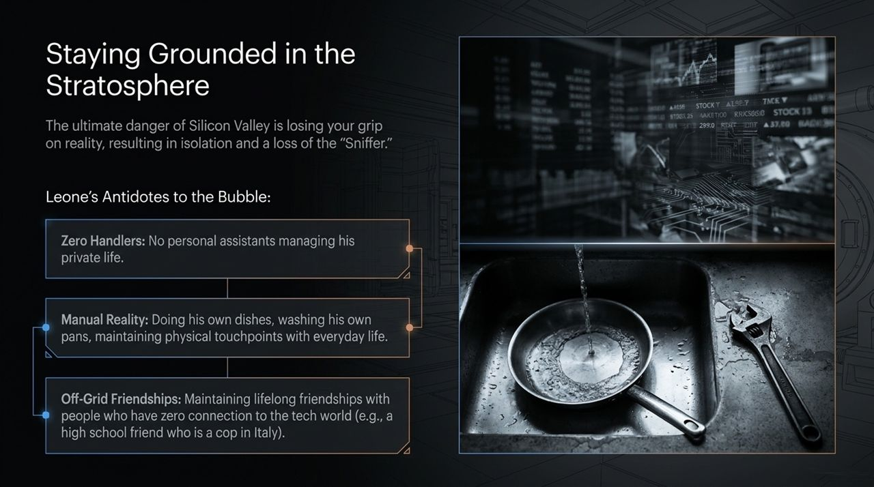
Notes:
Upon returning to Sequoia at age 69, Doug attended a weekly Monday "MIT" (Most Important Thing) meeting. While others reported ongoing tasks, Doug stated plainly: "I have zero going on. My MIT is to scrounge for deals."
"Scrounging" means dialing every contact, networking aggressively, and hunting for outlier founders.
The Challenge: At 69, Doug’s legacy network isn't naturally full of 23-year-old AI founders. Longevity demands stepping outside comfortable peer groups and hustling with raw, unpretentious energy.

Slide 14
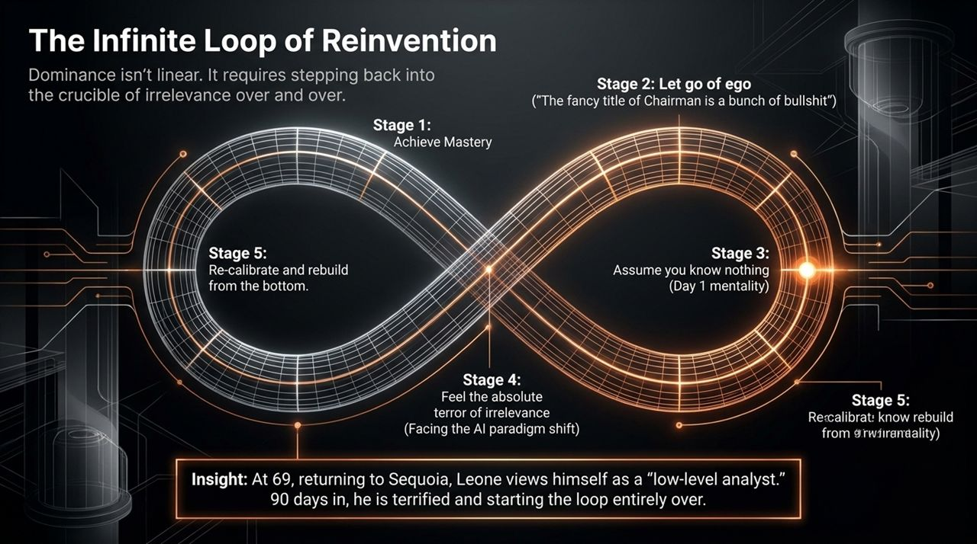
Notes:
Citing music producer Jimmy Iovine, Doug highlights that every legendary creator or operator has a "bend in the pipe"—a core internal flaw or obsession that drives both their genius and their dysfunction.
Elite founders aren't well-rounded, easygoing people; they are single-mindedly driven, often tortured internally into greatness.
If you look in the mirror every morning and demand more, your team will follow you into the trenches to achieve the impossible.

Slide 15
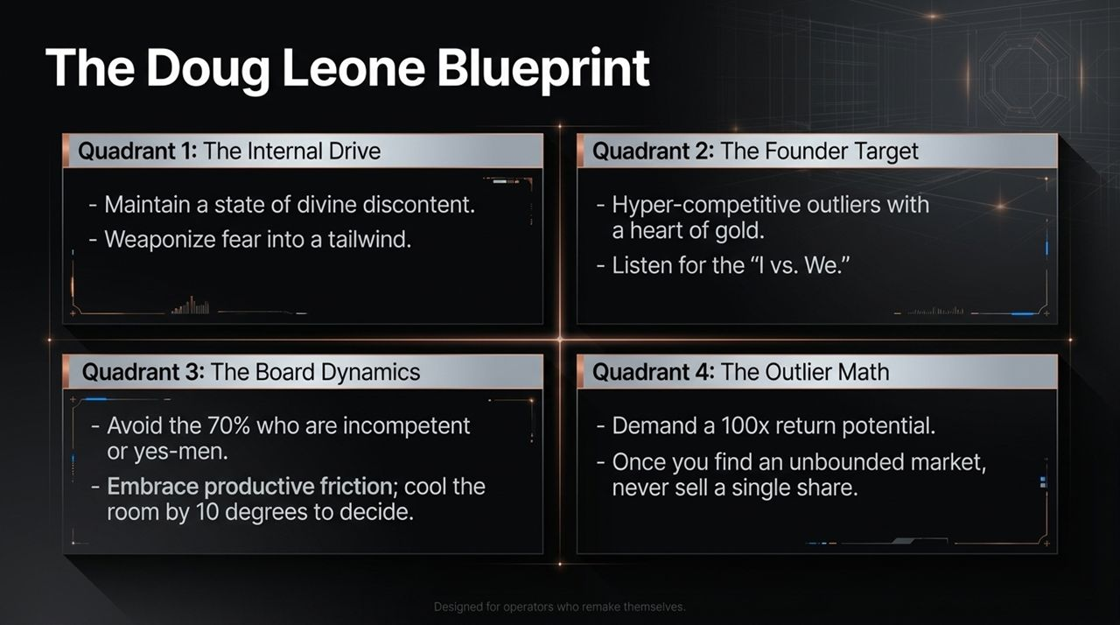
Notes:
Speed of execution relies on radical directness.
Doug contrasts Silicon Valley chatter with his direct style: While average managers spend 20–30 minutes in polite preamble on phone calls, Doug’s calls last less than 3 minutes.
"Hi. What do you need? Got it. Here’s the decision. Done."
Respecting time, cutting administrative fluff, and delivering direct truth accelerates every loop across the company.

Slide 16
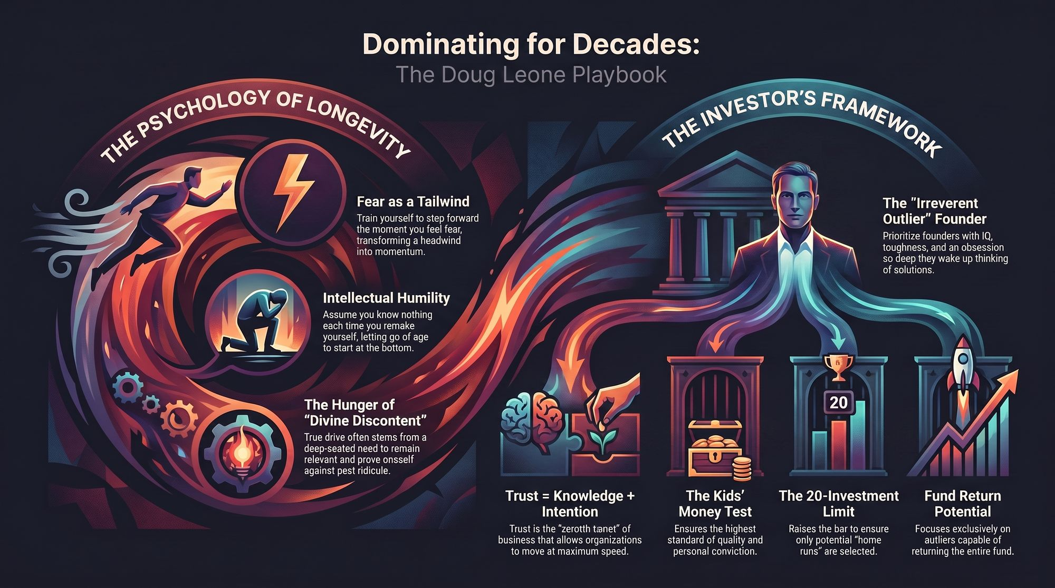
Notes:
To summarize the core tenets of The Leone Blueprint for building decades of dominance:
Fear as Propulsion: Don't avoid fear; face it head-on as a challenge.
Maintain Divine Discontent: Guard against the complacency of success.
Protect Founder Soul: VCs build scaffolding; founders supply the 0-to-1 black magic.
Apply the 100x Filter: Hold strictly for structural outliers; never sell unbounded category winners early.
Operate on Absolute Trust: Trust is the grease of high-speed execution.
Thank you. Let's open the floor to Q&A.

